Slide 1
Adversarial Search
Chapter 5
(Based on slides of Diane J. Cook, Stuart Russell)

Slide 2
Why Study Game Playing?
Games allow us to experiment with easier versions of real-world situations
Hostile agents act against our goals
Games have a finite set of moves
Games are fairly easy to represent
Good idea to decide about what to think
Perfection is unrealistic, must settle for good
One of the earliest areas of AI
Claude Shannon and Alan Turing wrote chess programs in 1950s
The opponent introduces uncertainty
The environment may contain uncertainty (backgammon)
Search space too hard to consider exhaustively
Chess has about 10⁴⁰ legal positions
Efficient and effective search strategies even more critical
Games are fun to target!

Slide 3
Games vs. search problems
"Unpredictable" opponent → specifying a move for every possible opponent reply
Time limits → unlikely to find goal, must approximate

Slide 4
Assumptions
Static or dynamic?
Fully or partially observable?
Discrete or continuous?
Deterministic or stochastic?
Episodic or sequential?
Single agent or multiple agent?

Slide 5
Zero-Sum Games
Focus primarily on “adversarial games”
Two-player, zero-sum games
As Player 1 gains strength
Player 2 loses strength
and vice versa
The sum of the two strengths is always 0.

Slide 6
Search Applied to Adversarial Games
Initial state
Current board position (description of current game state)
Operators
Legal moves a player can make
Terminal nodes
Leaf nodes in the tree
Indicate the game is over
Utility function
Payoff function
Value of the outcome of a game
Example: tic tac toe, utility is -1, 0, or 1

Slide 7
Using Search
Search could be used to find a perfect sequence of moves except the following problems arise:
There exists an adversary who is trying to minimize your chance of winning every other move
You cannot control his/her move
Search trees can be very large, but you have finite time to move
Chess has 10⁴⁰ nodes in search space
Some two-player games have time limits
Solution?
Search to n levels in the tree (n ply)
Evaluate the nodes at the nth level
Head for the best looking node

Slide 8
Static Board Evaluator
We cannot look all the way to the end of the game
Look ahead ply moves
Evaluate nodes there using SBE
Tic Tac Toe example
#unblocked lines with Xs - #unblocked lines with Os
Tradeoff
Stupid, fast SBE: Massive search
These are “Type A” systems
Smart, slow SBE: Very little search
These are “Type B” systems
Humans are Type B systems
Computer chess systems have been more successful using Type A
They get better by searching more ply

Slide 9
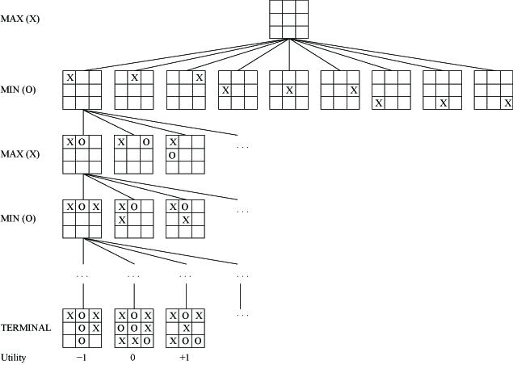
Game Trees -Tic tac toe
Two players, MAX and MIN
Moves (and levels) alternate between two players

Slide 10
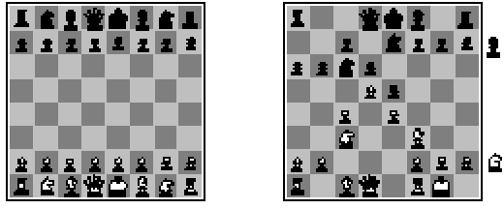
Chess
Chess, SBE is typically linear weighted sum of features
SBE(s) = w₁f₁(s) + w₂f₂(s) + … + w_{n}f_{n}(s)
E.g., w₁ = 9
F₁(s) = #white queens - #black queens

Slide 11
Cutting off search
MinimaxCutoff is identical to MinimaxValue except
Terminal? is replaced by Cutoff?
Utility is replaced by Eval
Does it work in practice?
b^{m} = 10⁶, b=35 → m=4
4-ply lookahead is a hopeless chess player!
For chess:
4 ply is human novice
8 ply is typical PC or human master
12 ply is grand master

Slide 12
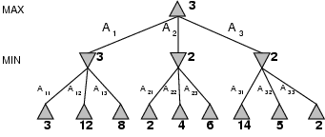
Minimax
E.g., 2-ply game:
Perfect play for deterministic games
Idea: choose move to position with highest minimax value = best achievable payoff against best play

Slide 13
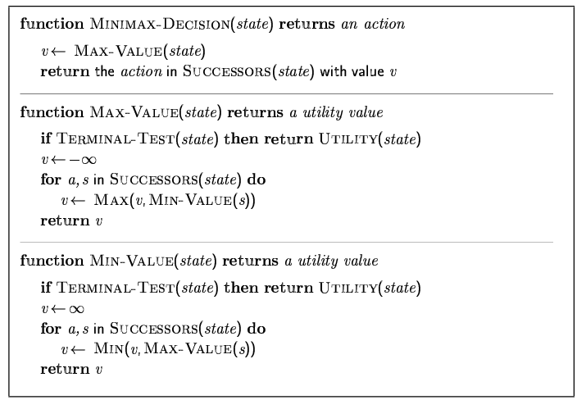
Minimax algorithm

Slide 14
Properties of minimax
Complete? Yes (if tree is finite)
Optimal? Yes (against an optimal opponent)
Time complexity? O(b^{m})
Space complexity? O(bm) (depth-first exploration)
For chess, b ≈ 35, m ≈100 for "reasonable" games → exact solution completely infeasible

Slide 15
Resource limits
Suppose we have 100 secs, explore 10⁴ nodes/sec → 10⁶ nodes per move Standard approach:
cutoff test:
e.g., depth limit
evaluation function
= estimated desirability of position

Slide 16
Alpha-Beta Pruning
Typically can only look 3-4 ply in allowable chess time
Alpha-beta pruning simplifies search space without eliminating optimality
By applying common sense
If one route allows queen to be captured and a better move is available
Then don’t search further down bad path
If one route would be bad for opponent, ignore that route also
Max
2
7
1
No need to
look here!
Maintain [alpha, beta] window at each node during depth-first search
alpha = lower bound, change at max levels
beta = upper bound, change at min levels

Slide 17
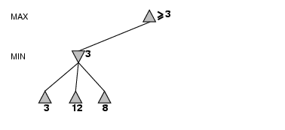
α-β pruning example

Slide 18
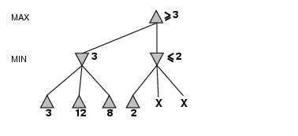
α-β pruning example

Slide 19
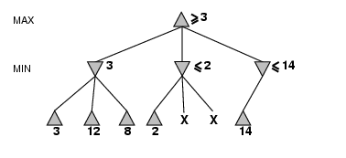
α-β pruning example

Slide 20
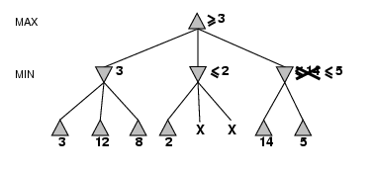
α-β pruning example

Slide 21
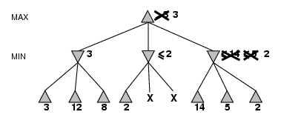
α-β pruning example

Slide 22
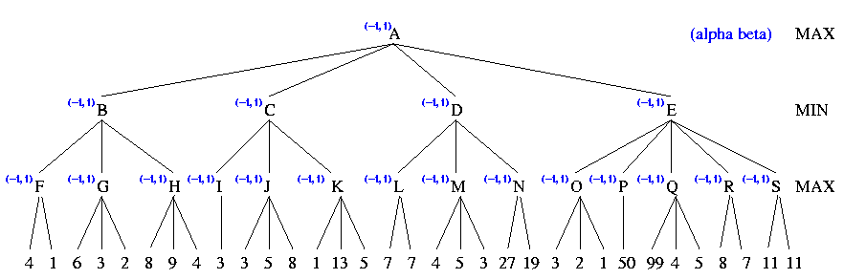
Example

Slide 23
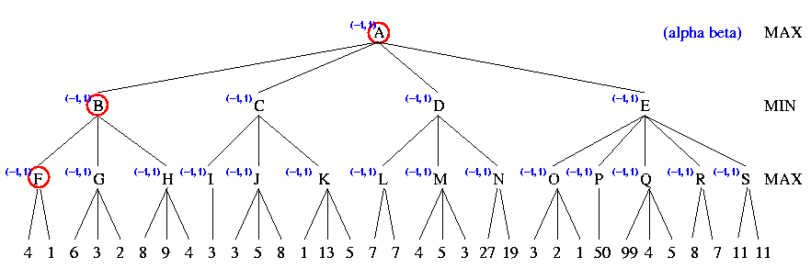
Example

Slide 24
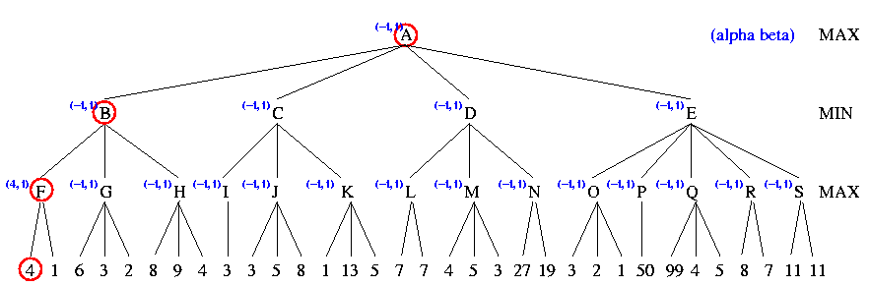
Example

Slide 25
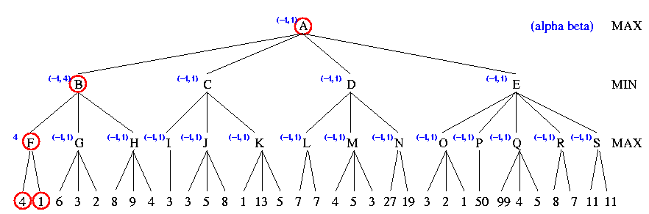
Example

Slide 26
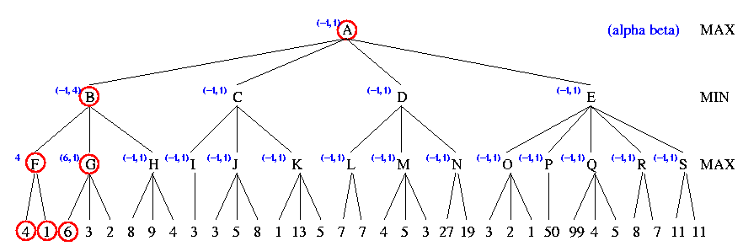
Example

Slide 27
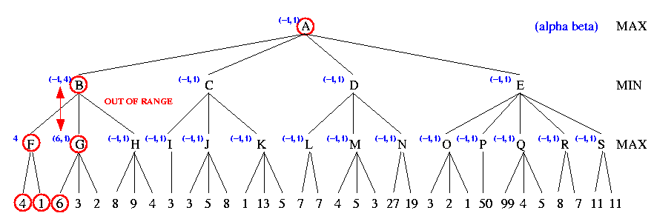
Example

Slide 28
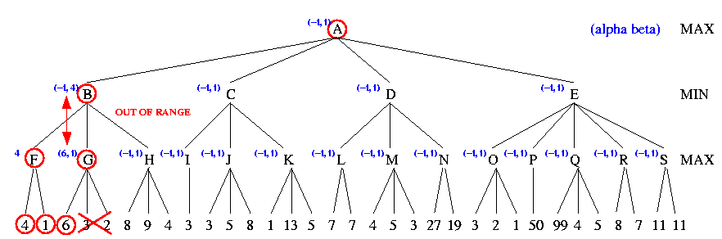
Example

Slide 29
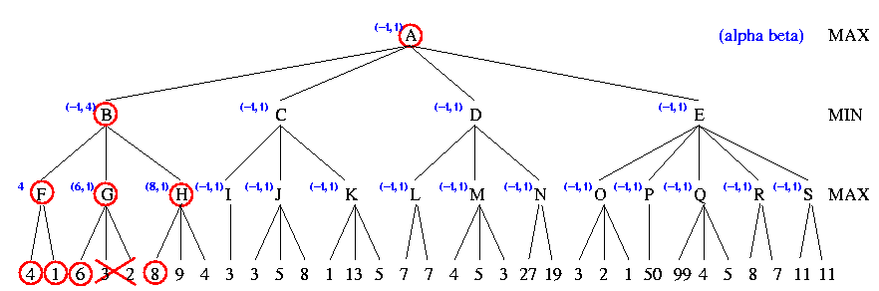
Example

Slide 30
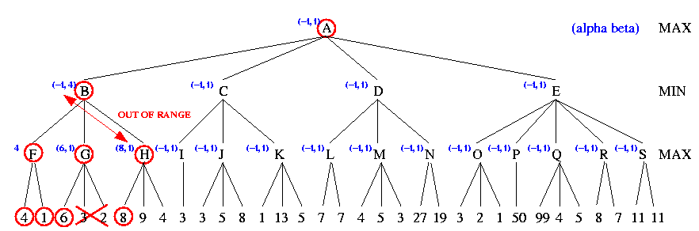
Example

Slide 31
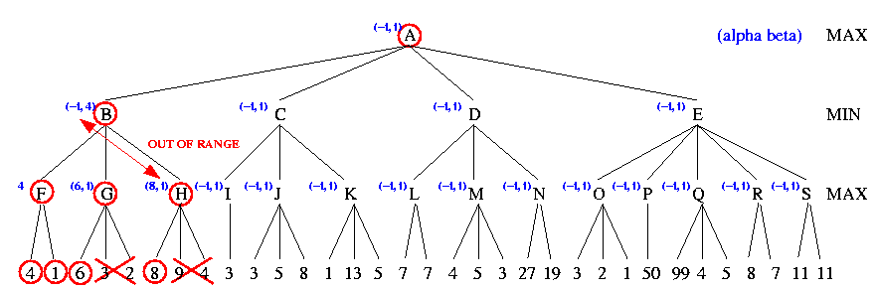
Example

Slide 32
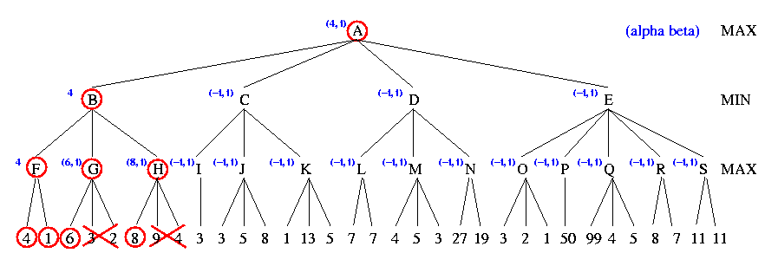
Example

Slide 33
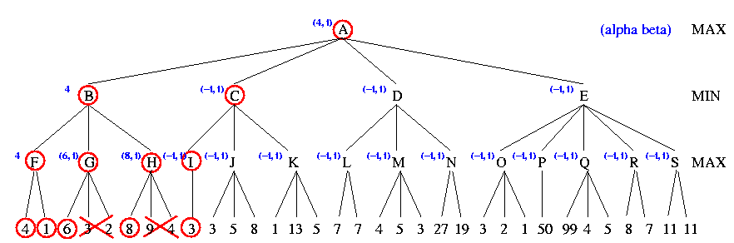
Example

Slide 34
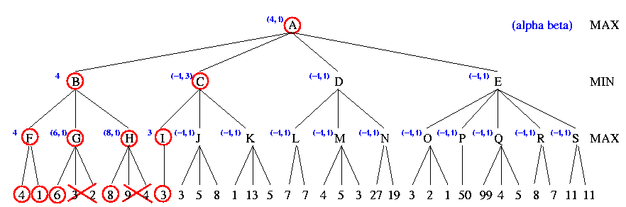
Example

Slide 35
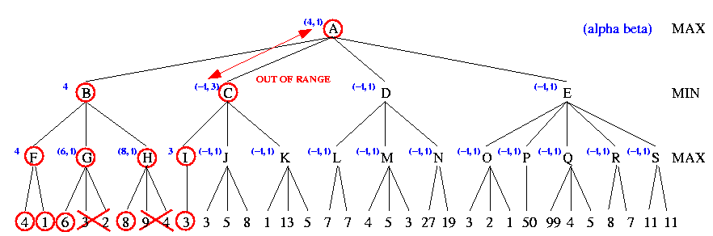
Example

Slide 36
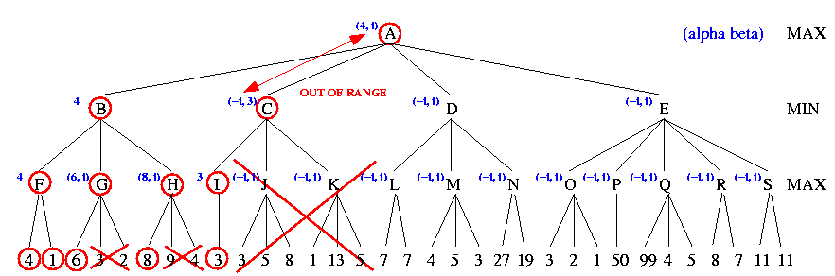
Example

Slide 37
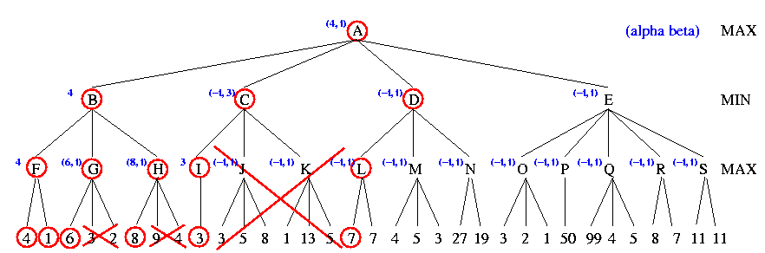
Example

Slide 38

Example

Slide 39
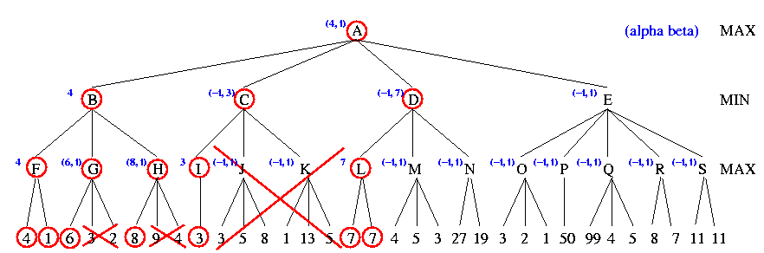
Example

Slide 40
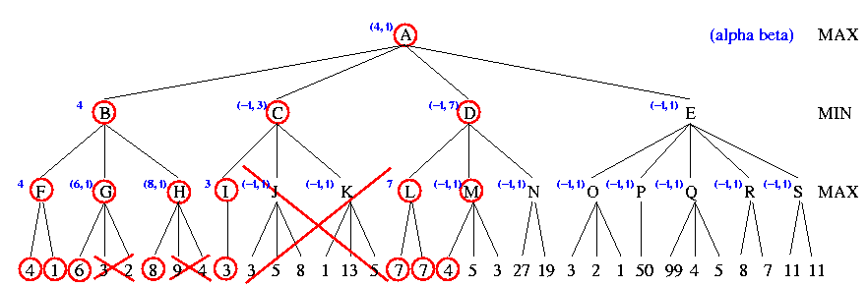
Example

Slide 41
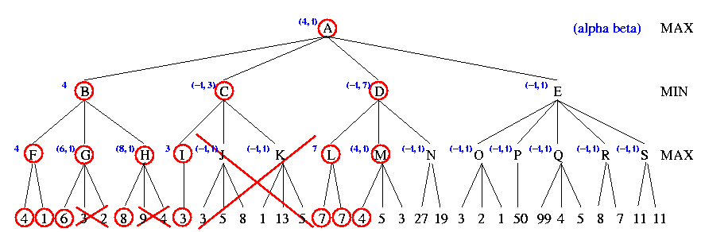
Example

Slide 42
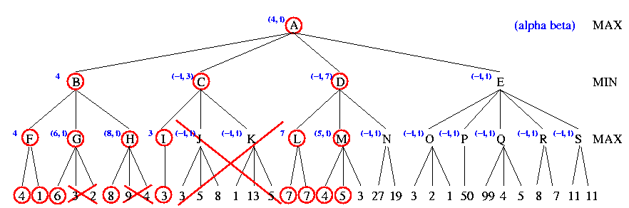
Example

Slide 43
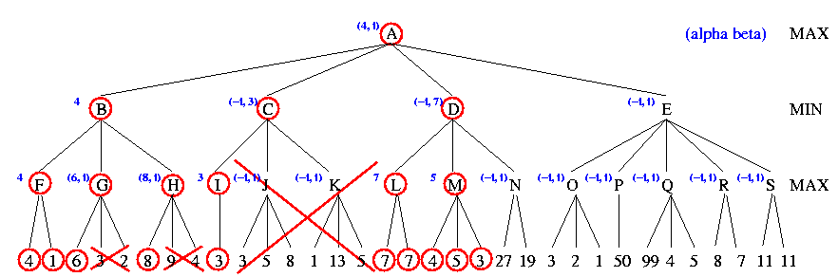
Example

Slide 44

Example

Slide 45
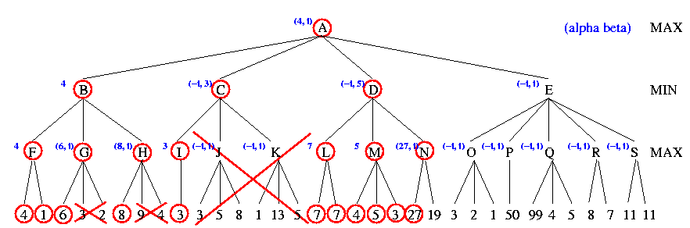
Example

Slide 46
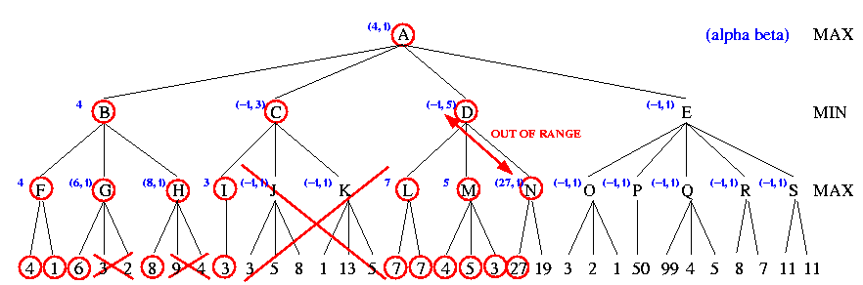
Example

Slide 47
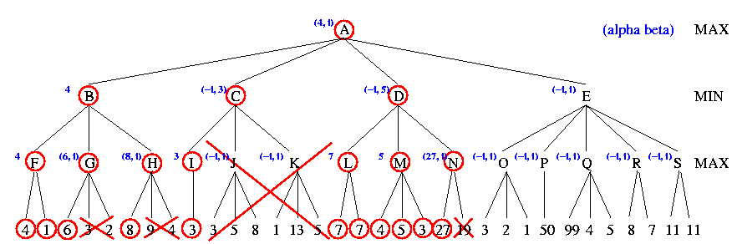
Example

Slide 48
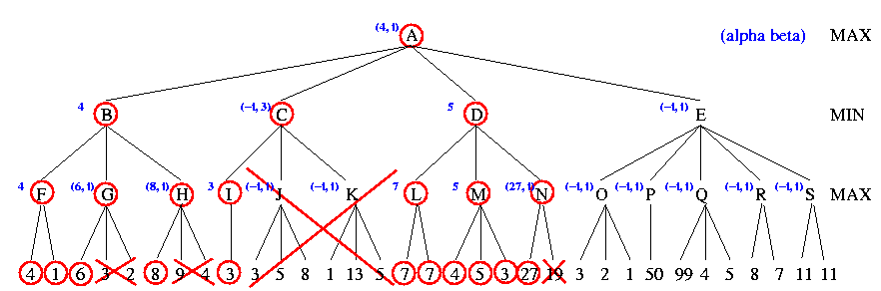
Example

Slide 49

Example

Slide 50
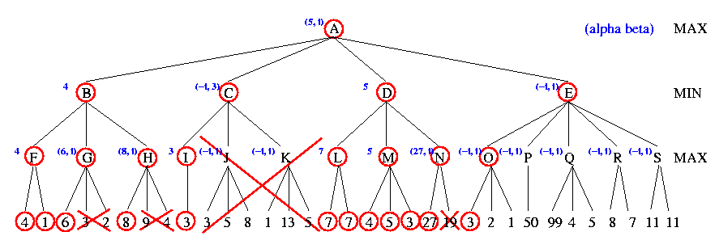
Example

Slide 51

Example

Slide 52
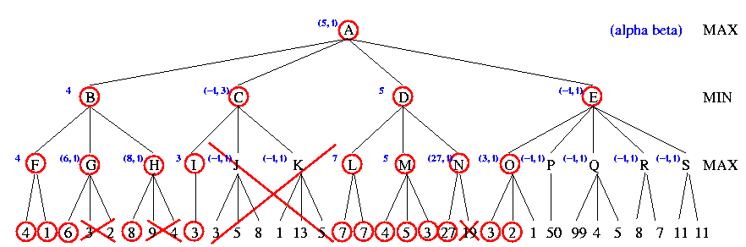
Example

Slide 53
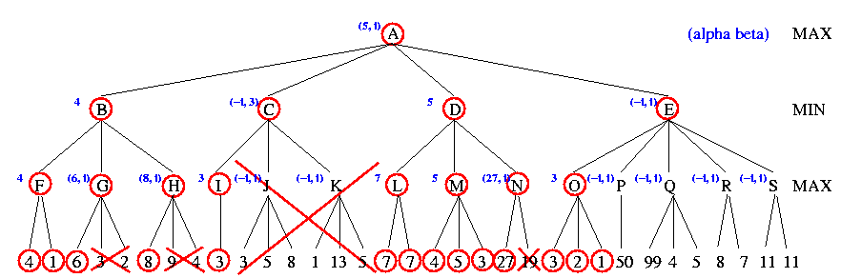
Example

Slide 54

Example

Slide 55
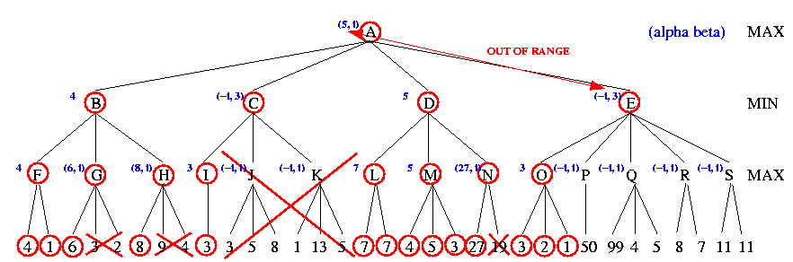
Example

Slide 56
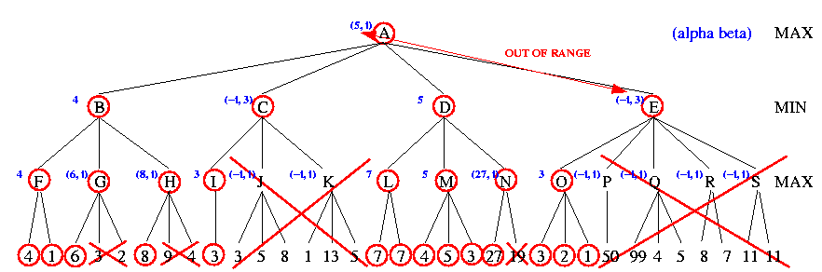
Example

Slide 57
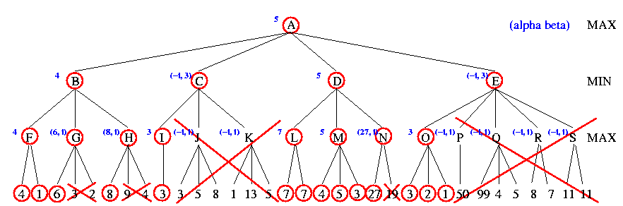
Example

Slide 58
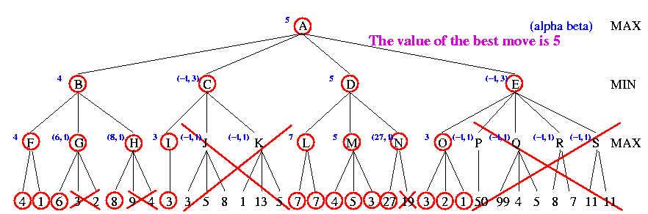
Example

Slide 59
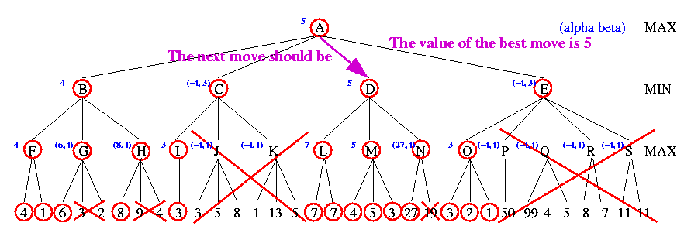
Example

Slide 60
Bad and Good Cases for Alpha-Beta Pruning
Bad: Worst moves encountered first
Good: Good moves ordered first
If we can order moves, we can get more benefit from alpha-beta pruning
4 MAX
+----------------+----------------+
2 3 4 MIN
+----+----+ +----+----+ +----+----+
6 4 2 7 5 3 8 6 4 MAX
+--+ +--+ +--+ +-+-+ +--+ +--+ +--+ +--+ +--+--+
6 5 4 3 2 1 1 3 7 4 5 2 3 8 2 1 6 1 2 4
4 MAX
+----------------+----------------+
4 3 2 MIN
+----+----+ +----+----+ +----+----+
4 6 8 3 x x 2 x x MAX
+--+ +--+ +--+ +--+ +-+-+
4 2 6 x 8 x 3 2 1 2 1

Slide 61
Properties of α-β
Pruning does not affect final result
Good move ordering improves effectiveness of pruning
With "perfect ordering," time complexity = O(b^{m/2})
→ doubles depth of search

Slide 62
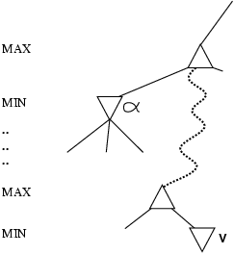
Why is it called α-β?
α is the value of the best (i.e., highest-value) choice found so far at any choice point along the path for max
If v is worse than α, max will avoid it
→ prune that branch
Define β similarly for min

Slide 63
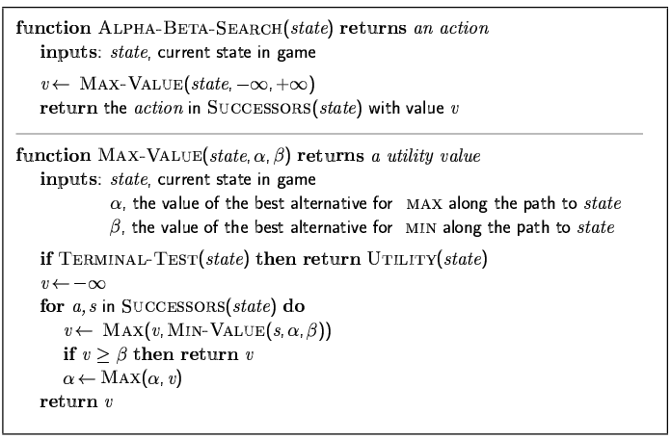
The α-β algorithm

Slide 64
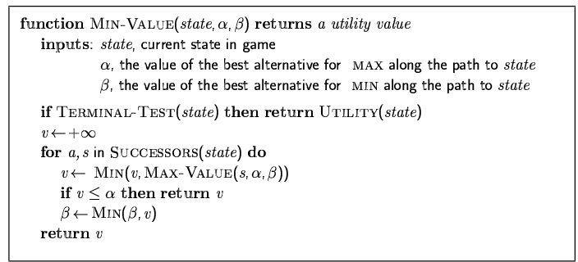
The α-β algorithm

Slide 65
Variations on 2-Player Games (Multiplayer Games)
to move
1 (1 2 3)
+------------------+ +---------------------+
2 (1 2 3) (-1 5 2)
+--------+ +-----+ +--------+ +-------+
3 (1 2 3) (6 1 2) (-1 5 2) (5 4 5)
/ \ / \ / \ / \
1 (1 2 3) (4 2 1) (6 1 2) (7 4 -1) (5 -1 -1) (-1 5 2) (7 7 -1) (5 4 5)
Each player maximizes utility
Each node stores a vector of utilities
Entire vector is backed up the tree
3-player example: If in leftmost state, should player 3 choose first move because higher utility values?
Result will be terminal state with utility values (v1=1, v2=2, v3=3)
This vector is backed up to the parent node
Need to consider cooperation among players

Slide 66
Summary
Games are fun to work on!
They illustrate several important points about AI
perfection is unattainable → must approximate
good idea to think about what to think about

